Slide 1

Chapter 6
Security in the Network and Internet

Slide 2
Chapter Outline
Networks
Characteristics
Dimensions
Protocols
Types
Threats and Attacks
Vulnerabilities
Security Controls
Firewalls
Intrusion Detection Systems
Secure E-Mail

Slide 3
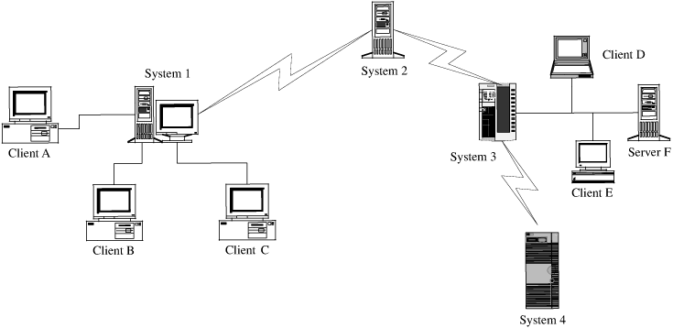
Difference Between a Network and a Stand-alone Device
The environment in which each operates
Although some networks are located in protected spaces (for example, a LAN), at least some portion of most networks is exposed, often to total strangers
For Example, Systems 2, 3, and 4 are remote from System 1, and they may be under different ownership or control
A Typical View of Networks

Slide 4
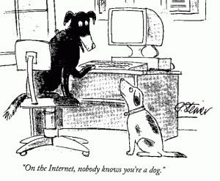
Networks Typical Characteristics
Anonymity
Automation
Some nodes as well as all intermediate points may be machines with only minimal human supervision
Distance
Opaqueness
Routing diversity
Routings are usually dynamic to maintain or improve reliability and performance
Notes:
Opaque networking enhances privacy in communication protocols by obscuring the content and metadata of network traffic.

Slide 5
Networks Dimensions
Boundary
Distinguishes an element of the network from an element outside it
Ownership
The network administrator’s organization may own the network infrastructure, including the cable and network devices
However, certain hosts may be connected to a network for convenience, not necessarily implying ownership.
Control
If ownership is uncertain, control must be, too
For an arbitrary host
Is it part of network A?
If yes, is it under the control of network A’s administrator?
Does that administrator establish access control policies for the network?
Does that administrator determine when its software must be upgraded and to what version?

Slide 6
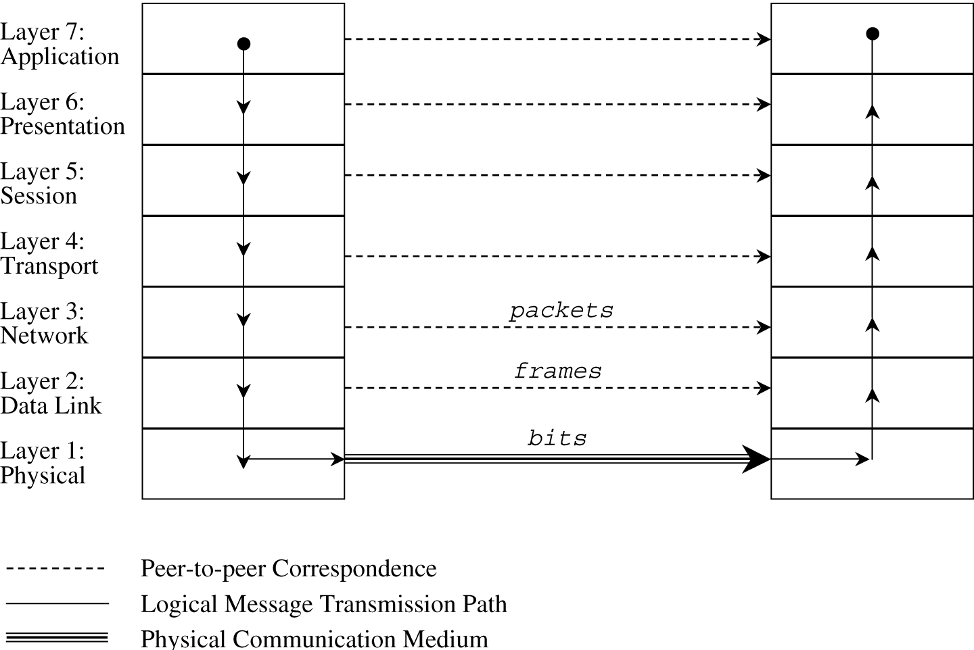
Networks Protocols
Allow a user to view the network at a high, abstract level of communication
A layered architecture for communications
ISO OSI Network Model
Notes:
The Open Systems Interconnection (OSI) model is a reference model from the International Organization for Standardization (ISO) that "provides a common basis for the coordination of standards development for the purpose of systems interconnection."

Slide 7
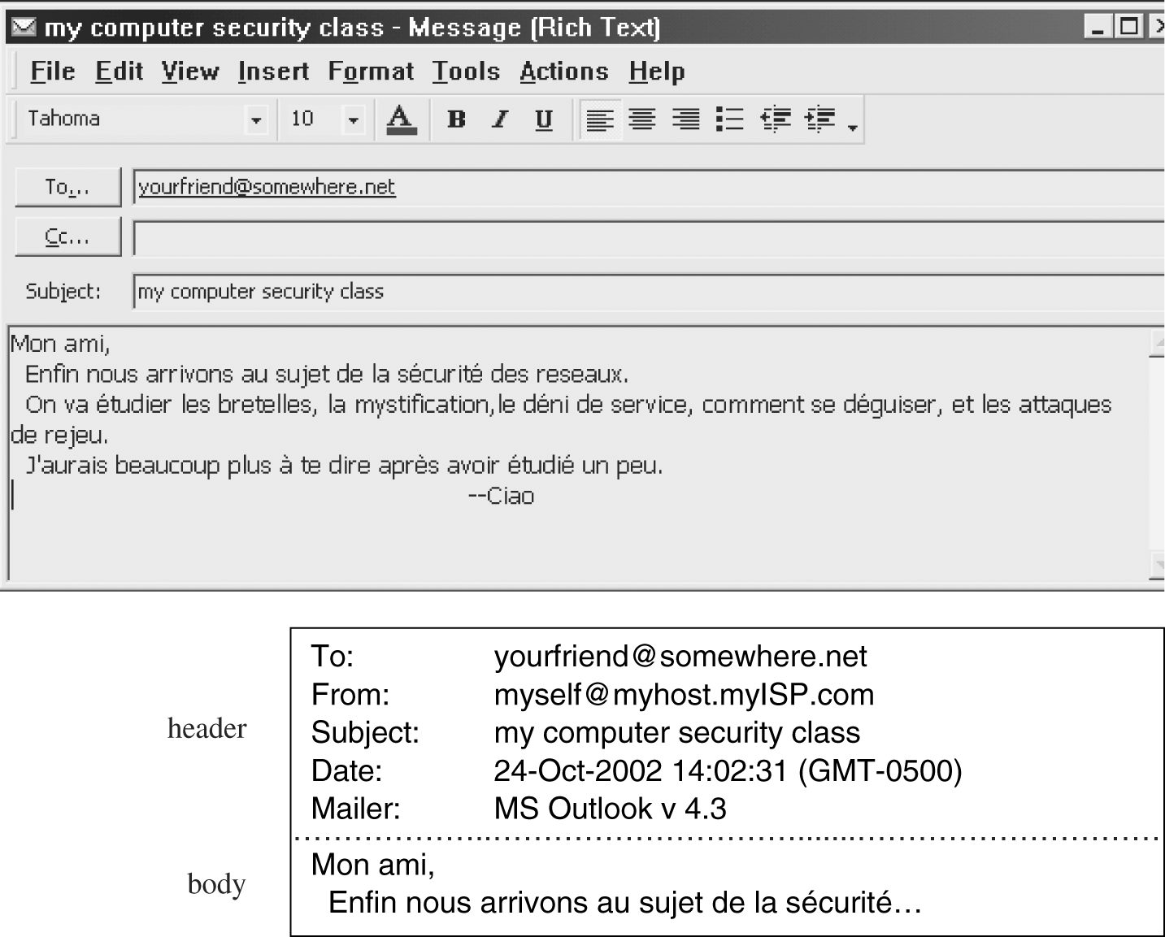
Networks Protocols (cont.)
Application Layer

Slide 8
Networks Protocols (cont.)
Presentation Layer
Standardized data appearance, blocking, text compression
Compression
Character conversions
Cryptography
…
Session Layer
Sessions or logical connections between parts of an application
Message sequencing
Recovery
Transport Layer
Flow control, end-to-end error detection and correction, priority service

Slide 9
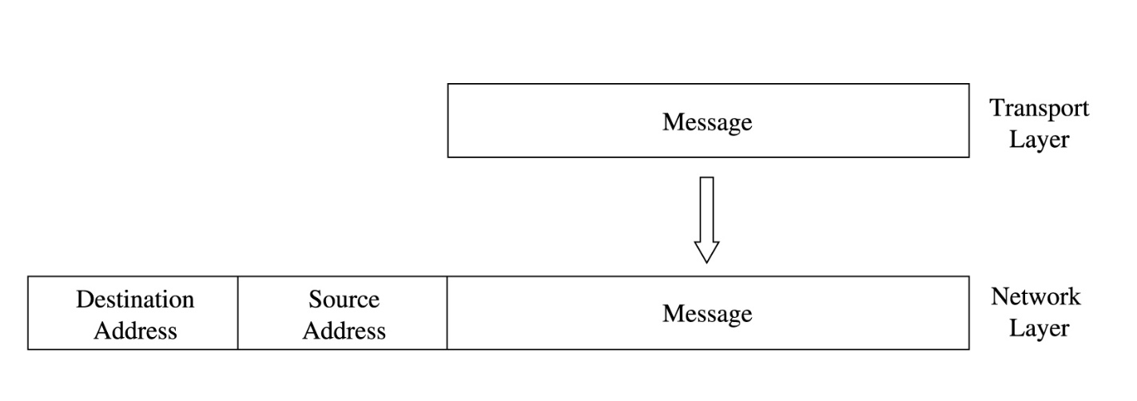
Networks Protocols (cont.)
Network Layer
Routing, message blocking into uniformly sized packets
Example
adds two headers to show your computer’s address as the source and somewhere.net’s address as the destination

Slide 10
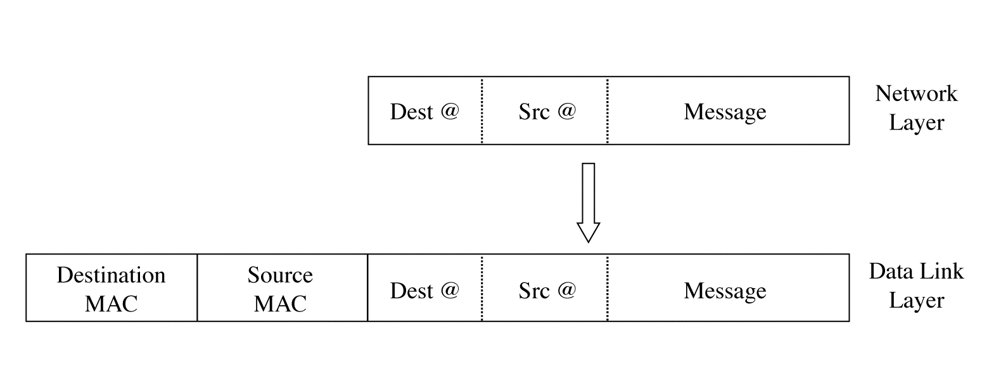
Networks Protocols (cont.)
Data Link Layer
Reliable data delivery over physical medium; transmission error recovery, separating packets into uniformly sized frames
Every computer connected to a network has a Network Interface Card (NIC) with a unique physical address, a MAC address
Two more headers are added, one for your computer’s NIC address and one for your router’s NIC address. A data link layer structure with destination MAC, source MAC, and data is called a frame.

Slide 11
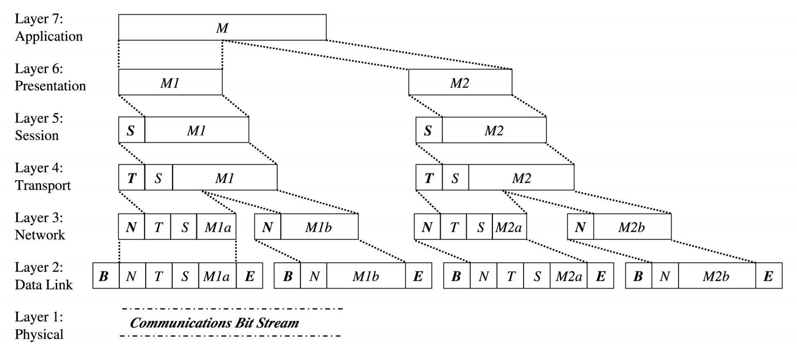
Networks Protocols (cont.)
Physical Layer
Actual communication across physical medium; individual bit transmission
Message Prepared for Transmission

Slide 12
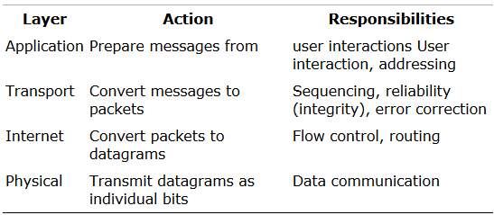
Networks Protocols (cont.)
TCP/IP (Transmission Control Protocol/Internet Protocol)
Full implementation of a seven-layer transmission carries too much overhead for megabit-per-second communications
TCP/IP is the protocol stack used for most wide area network communications
TCP/IP was invented for what became the Internet
TCP/IP is defined by protocols, not layers

Slide 13
Networks Protocols (cont.)
TCP/IP (cont.)
Must ensure the correct sequencing of packets
Must ensure for the integrity (correct transmission) in packets
It puts out-of-sequence packets in proper order
It calls for retransmitting missing packets
It obtains fresh copy of damaged packets
A TCP packet
A data structure that includes
A sequence number
An acknowledgment number for connecting the packets of a communication session
Flags
Source and destination port numbers
A port is a number designating a particular application running on a computer
80 for HTTP (web pages), 23 for Telnet (remote terminal connection), 25 for SMTP (e-mail), or 161 for SNMP (network management)

Slide 14
Networks Protocols (cont.)
TCP/IP (cont.)
A layer will typically subdivide data it receives from a higher layer
Then add header and/or trailer information to the data before passing it to a lower layer
Each layer encapsulates the higher layer, so that higher layer headers and trailers are seen simply as part of the data to be transmitted.
Addressing Scheme
IP address
IPv4
32-bit address, expressed as four 8-bit groups in decimal notation, separated by periods, such as 100.24.48.6
IPv6
128-bit address, expressed as eight 16-bit groups in hexadecimal notation, separated by colons, such as FE80:0000:0000:0000:0202:B3FF:FE1E:8329

Slide 15
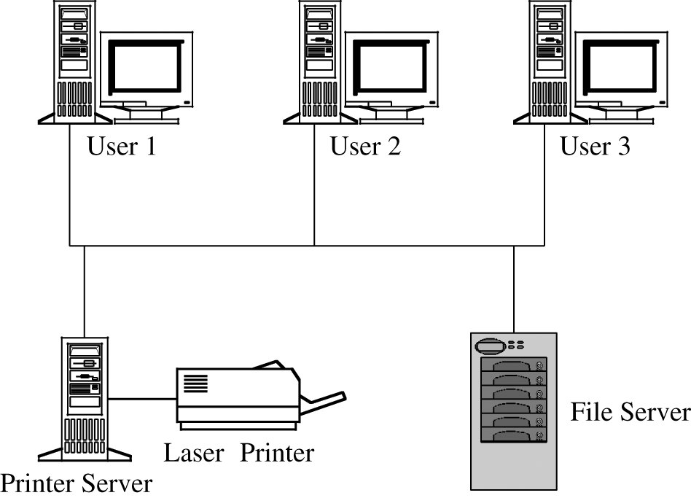
Types of Networks
Local Area Networks (LAN)
Covers a small distance, typically within a single building
Connects several small computers, such as personal computers, as well as printers and perhaps some dedicated file storage devices;
Typical LAN

Slide 16
Types of Networks (cont.)
LANs characteristics
Small
Typically, fewer than 100 users share a single LAN
Within a distance less than 3 kilometers, or 2 miles
Locally Controlled
The equipment is owned and managed by a single organization
The users all are affiliated with a single organization
Physically Protected
The LAN is on the premises of a company or other organization, so malicious outsiders usually cannot readily get to the LAN equipment.
Limited Scope
Many LANs support a single group, department, floor, activity, or other geographical or administrative unit
Each group has a narrowly scoped set of functions it performs

Slide 17
Types of Networks (cont.)
Wide Area Networks (WAN)
Differs from a LAN in terms of
Size or distance
It covers a wider geographic area than does a LAN
Control or ownership
It is more likely not to be owned or controlled by a single body
WAN Characteristics
Single control
Typically, a single organization is responsible for and controls a WAN
Even if a network is shared by several unrelated subscribers, one organization usually determines who may join the network
Covers a significant distance
A WAN generally serves a distance typically from a few miles to the entire globe
Physically exposed
Most WANs use publicly available communications media
However, the fact that many subscribers share those media helps protect the privacy of any one subscriber
Notes:
Since WANs often use publicly available communication channels shared by multiple users, individual users' activities or data can be more difficult to isolate or identify. In essence, the large volume of shared usage adds a layer of anonymity, which helps to protect the privacy of any single user, making it harder for outside parties to pinpoint and extract specific data from one individual.

Slide 18
Types of Networks (cont.)
Internetworks (Internets)
Networks of networks
A connection of two or more separate networks, separately managed and controlled
A federation of networks, loosely controlled by the Internet Society (ISOC) and the Internet Corporation for Assigned Names and Numbers (ICANN)
Internet Characteristics
Federation
No general statements can be made about Internet users or even network service providers
Enormous
No one really knows how large the Internet is
In 2024 there were almost 1.98 billion Internet hosts and well over 5.35 billion users
We can expect the size of the Internet to double each year
Heterogeneous
Physically and logically exposed
Since there is no global access control, practically any attacker can access the Internet

Slide 19
Threats in Networks
What Makes a Network Vulnerable?
Network Characteristics
Anonymity
The potential attacker is safe behind an electronic shield
The attack can be passed through many other hosts in an effort to disguise the attack’s origin
Many points of attack—both targets and origins
When a file is stored in a network host remote from the user, the data or the file itself may pass through many hosts to get to the user, with various security policies
Administrators have no control over other hosts in the network
Sharing
Because networks enable resource and workload sharing, more users have the potential to access networked systems than on single computers

Slide 20
Threats in Networks (cont.)
What Makes a Network Vulnerable? (cont.)
Network Characteristics (cont.)
Complexity of system
A network combines two or more possibly dissimilar operating systems
A network operating/control system is likely to be more complex than an operating system for a single computing system
The attacker can use computing power of other computers to advantage by causing the victim’s computer to perform part of the attack’s computation

Slide 21
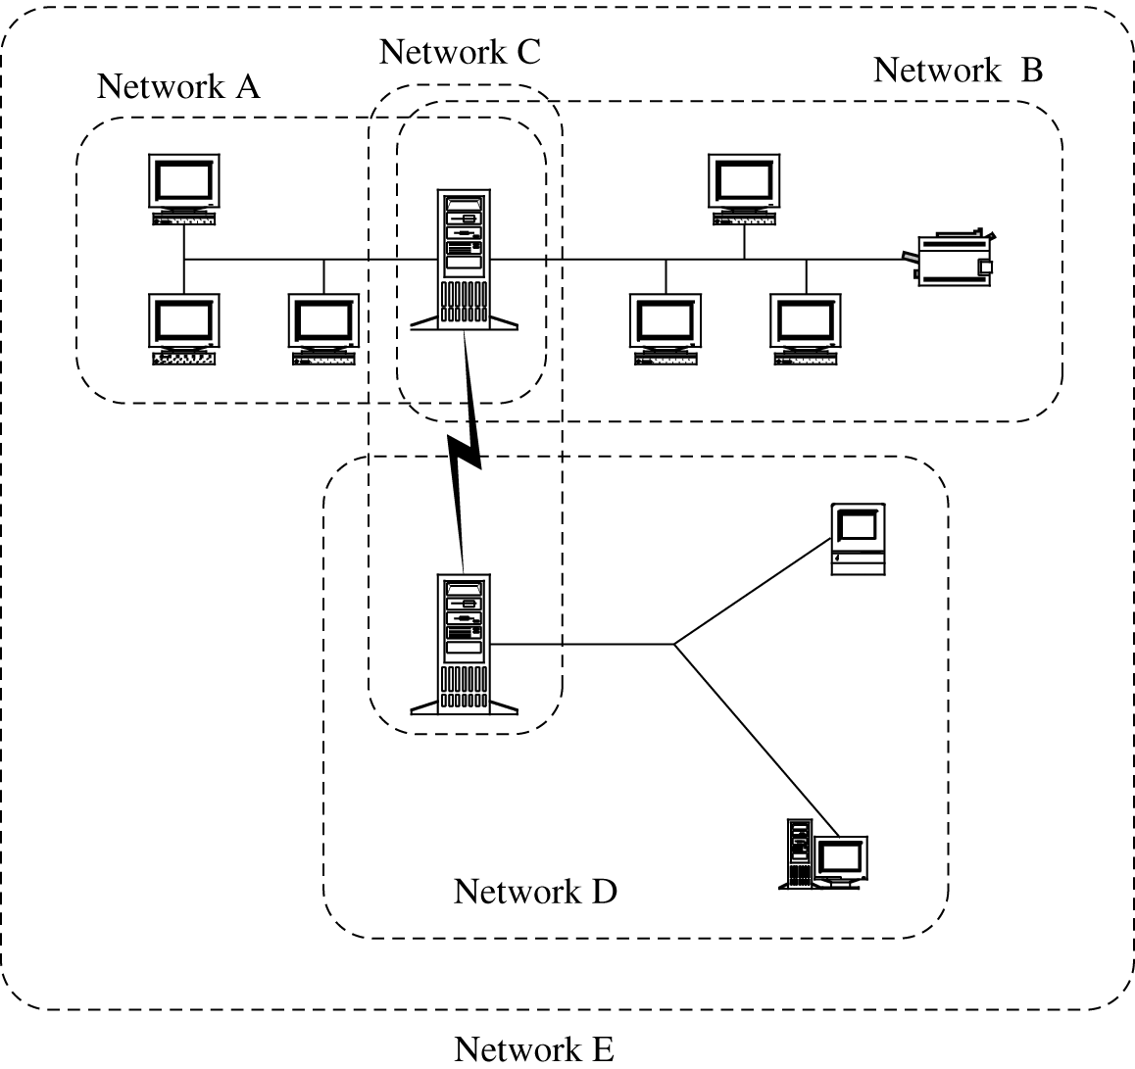
Threats in Networks (cont.)
What Makes a Network Vulnerable? (cont.)
Network Characteristics (cont.)
Unknown perimeter
A network’s expandability also implies uncertainty about the network boundary
Although wide accessibility is an advantage, unknown or uncontrolled group of possibly malicious users is a security disadvantage

Slide 22
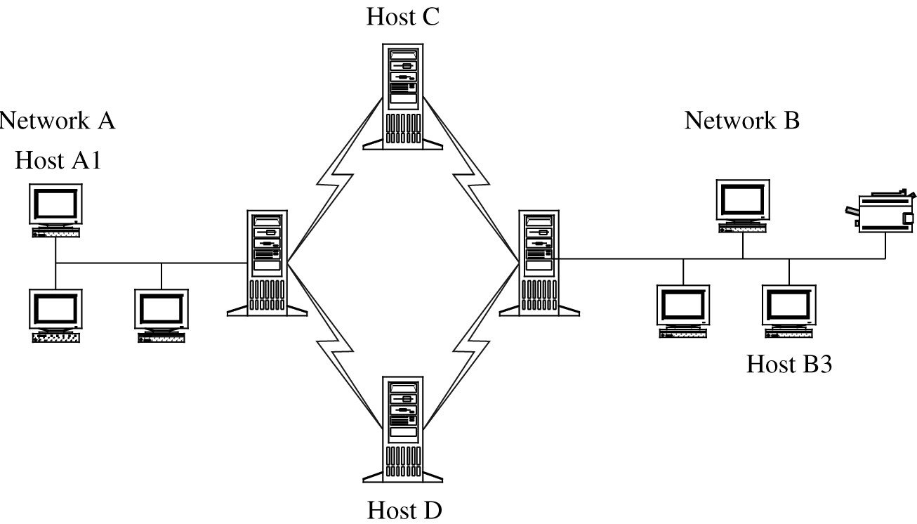
Threats in Networks (cont.)
What Makes a Network Vulnerable?
Network Characteristics (cont.)
Unknown path
There may be many paths from one host to another
Network users seldom have control over the routing of their messages

Slide 23
Motives of Attackers
Intellectual challenge or power
Can I defeat this network?
What would happen if I tried this approach or that technique?
Fame
Seeking recognition and credit for their activities
Money and Espionage
Seeking information on a company’s products, clients, or long-range plans
Organized Crime
Collaborators from several countries
Ideology
Political and/or religious reasons
Cyber-terrorism

Slide 24
Precursors to an Attack
Understanding the context of the target
Port Scan
A program that, for a particular IP address, reports
Which ports respond to messages
Which of several known vulnerabilities seem to be present.
Tells an attacker
Which standard ports or services are running and responding on the target system
What operating system is installed on the target system
What applications and versions of applications are present
Social Engineering
Using social skills and personal interaction to get someone to reveal security-relevant information
Impersonate someone inside the organization

Slide 25
Precursors to an Attack (cont.)
Understanding the context of the target (cont.)
Intelligence
Gathering discrete bits of information from various sources
Putting them together like the pieces of a puzzle
Techniques
Dumpster diving
Eavesdropping
OS and Application Fingerprinting
Sending meaningless messages
Receiving meaningful responses
Example
Server: Netscape-Commerce/1.12
Your browser sent a non-HTTP compliant message.
or
Microsoft ESMTP MAIL Service, Version: 5.0.2195.3779

Slide 26
Precursors to an Attack (cont.)
Understanding the context of the target (cont.)
Bulletin Boards and Chats
Availability of Documentation
The best defense against reconnaissance is
Give out as little information about your site as possible

Slide 27
Type of Attacks
Eavesdropping
Passive Wiretapping
Active Wiretapping
Impersonation
Guess the identity and authentication details
Weak passwords (111111, 123456, password, qwerty, …)
Default passwords (Guest, Admin, null, …)
Working on (temporarily) dead accounts
Authentication obtained by Eavesdropping or Wiretapping
Nonexistent Authentication
Access through computers in trusted list

Slide 28
Type of Attacks (cont.)
Spoofing
Masquerade
URL confusion
coca-cola.com and cocacola.com
citibank.com and citybank.com
Phishing
Acquire sensitive information by masquerading as a trustworthy entity
Session Hijacking
Intercepting and carrying on a session begun by another entity
Example
Hijack an online purchase at the time of checkout

Slide 29
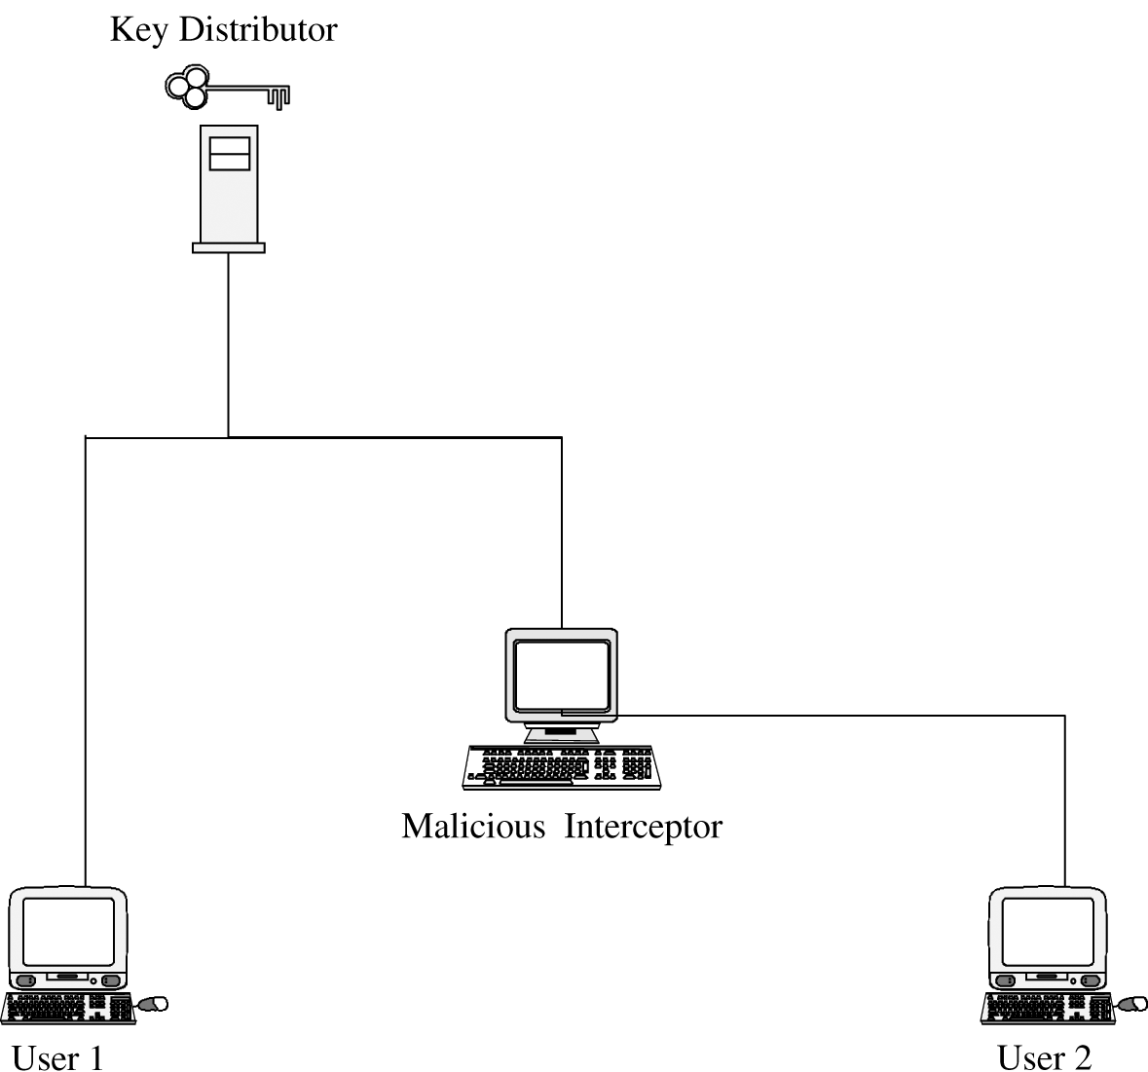
Type of Attacks (cont.)
Spoofing (cont.)
Man-in-the-Middle Attack
One entity intrudes between two others
Attacker participates from the start of the session
Key Interception by a Man-in-the-Middle Attack

Slide 30
Web Site Vulnerabilities
Web Site Defacement
Change the visual appearance of a website or a webpage
Buffer Overflows
Feed a program far more data than it expects to receive
A buffer size is exceeded, and the excess data spill over into adjoining code and data locations
Dot-Dot-Slash (directory or path traversal)
Access a server file that is not intended to be accessible (such as editors and utilities)
Application Code Errors
Time-of-check to time-of-use flaw
Server-Side Include
Execute OS commands using web command fields, such as email and if inside the web pages

Slide 31
Denial of Service (DOS Attack)
Connection Flooding
Attacker sends as much data as the target server can handle
Using Internet Control Message Protocols (ICMP)
ping: Requests a destination to return a reply
Ping of Death
Smurf
echo: Requests a destination to return the data sent to it
Echo-Chargen
destination unreachable: Indicates that a destination address cannot be accessed
source quench: Means that the destination is becoming saturated and the source should suspend sending packets for a while

Slide 32
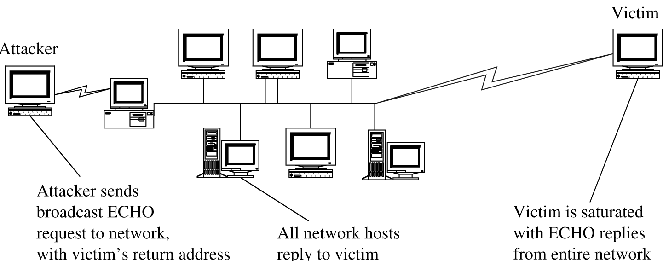
Denial of Service (DOS Attack) (cont.)
Connection Flooding (cont.)
Smurf
Large numbers of ping packets with the victim's spoofed source IP are broadcast to a network of unwitting victims using an IP Broadcast address.
They will respond by sending a reply to the source IP address.
The victim's computer will be flooded with traffic.

Slide 33
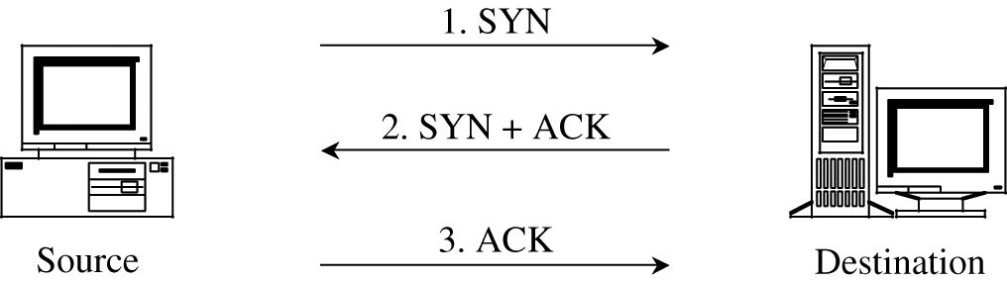
Denial of Service (DOS Attack) (cont.)
Connection Flooding (cont.)
Syn flood
Attacker can deny service to the target by sending many SYN requests and never responding with ACKs, thereby filling the victim’s SYN_RECV queue.
Three-Way Connection Handshake.

Slide 34
Denial of Service (DOS Attack) (cont.)
DNS Attacks
A domain name system server translates domain names into IP addresses.
If the server doesn't know a requested translation it will ask another server.
DNS Flooding: Sending an overwhelming number of DNS requests to the server, consuming its resources.
DNS Amplification: An attacker sends small queries to open DNS servers with a spoofed IP address (the IP address of the victim) to trigger large responses, causing the DNS server to respond to the victim with a flood of data.
DNS Reflection: Attackers send requests to DNS servers, using the target's IP address as the return address, causing the target to be flooded with DNS query responses.

Slide 35
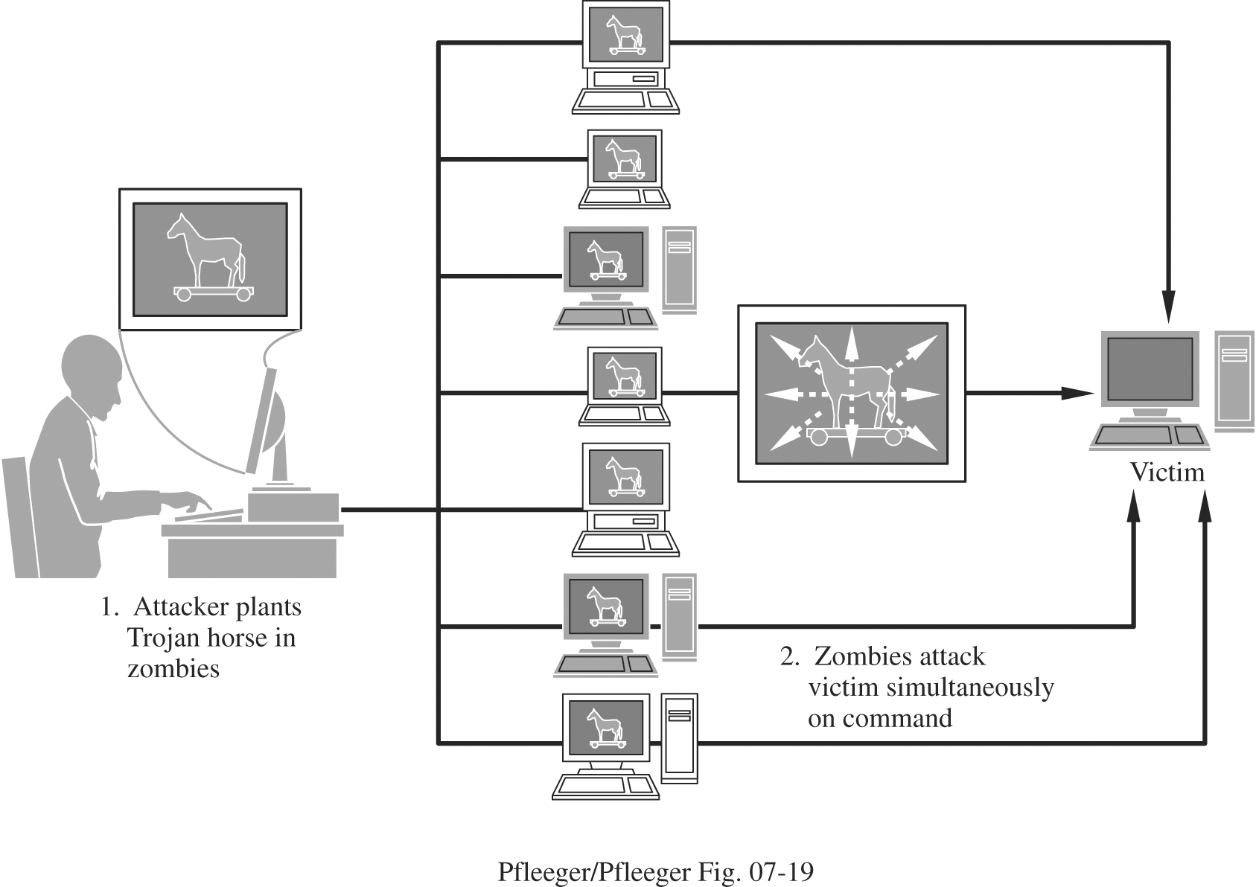
Denial of Service (DOS Attack) (cont.)
Distributed Denial of Service (DDOS)
Attacker plants a Trojan horse, including various types of DOS attacks, on some target machines.
At some point the attacker chooses a victim and sends a signal to all the zombies (target machines) to launch the attack.
Then, instead of the victim’s trying to defend against one DOS attack, it must try to counter n attacks from the n zombies all acting at once.

Slide 36
Cookies and Scripts
Cookies
A data object that can be held in memory (per-session cookie) or stored on disk for future access (persistent cookie)
A cookie is something that
Takes up space on your disk
Holding information about you that you cannot see
Forwarded to servers you do not know whenever the server wants it, without informing you
Scripts
An attack from client to server
A browser organizes user inputs into parameters to a defined script
It then sends the script and parameters to a server to be executed.
The server cannot distinguish between commands generated from a user and a user’s handcrafting a set of orders.
The malicious user can monitor the communication between a browser and a server to see how changing a web page entry affects what the browser sends and then how the server reacts, and manipulate the server’s actions.
http://www.test.com/cgi-bin/query?%0a/bin/cat%20/etc/passwd

Slide 37
Active Code
Java Code
A hostile applet is downloadable Java code that can cause harm on the client’s system
ActiveX controls
Objects of arbitrary type can be downloaded to a client
Auto Exec by Type
When a file arrives with an extensions, the OS automatically invokes the appropriate processor to handle it.
It gives an opportunity to an attacker, such as running malicious macros, from inside a .doc file
Bots
Pieces of malicious code under remote control
Used for DDOS attacks, launching attacks from many sites in parallel against a victim
Used for spam and other bulk email attacks

Slide 38
Network Security Controls
Three steps of a security threat analysis
Scrutinize all the parts of a system so that we know what each part does and how it interacts with other parts.
Consider possible damage to
Confidentiality
Integrity
Availability
Hypothesize the kinds of attacks that could cause this damage.
Same steps can be taken with a network

Slide 39
Network Security Controls (cont.)
Individual parts of a network
Local
nodes
communications links
area network
data storage
processes
Devices
Network
gateway
communications
control resources
routers
resources, such as databases

Slide 40
Network Security Controls (cont.)
Malicious activities an attacker might perform
Read communications
Modify communications
Forge communications
Inhibit communications
Inhibit all communications passing through a point
Read data
Modify or destroy data
In other words
Intercepting data in traffic
Accessing programs or data at remote hosts
Modifying programs or data at remote hosts
Modifying data in transit
Inserting communications
Impersonating a user
Inserting a repeat of a previous communication
Blocking selected traffic
Blocking all traffic
Running a program at a remote host

Slide 41
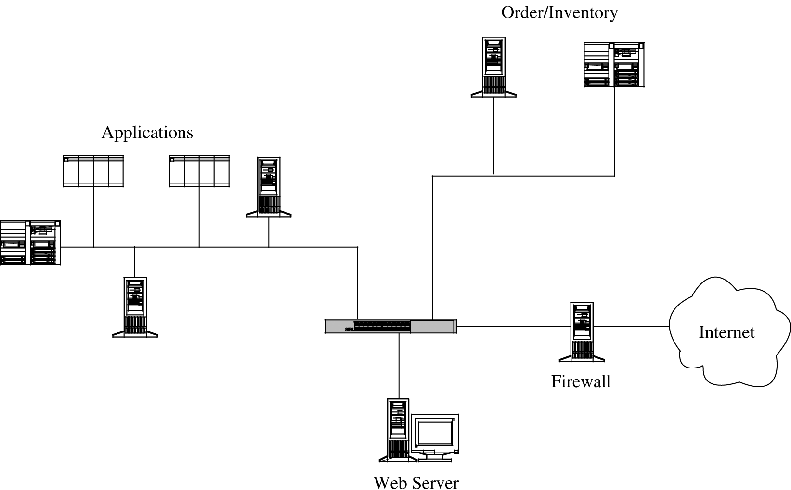
Network Security Controls (cont.)
Network Design (Architecture) Concerns
Segmentation
Do not run all the activities on one machine
Distribute the tasks based on the principles of least privilege and encapsulation

Slide 42
Network Security Controls (cont.)
Network Design (Architecture) Concerns (cont.)
Redundancy
Allowing a function to be performed on more than one node
Failover mode
Servers communicate with secondary server periodically
Single Point of Failure
Single point in the network that, if it were to fail, could deny access to all or a significant part of the network
Distributing the database by placing copies of it on different network segments
Mobile Agents
Using mobile code and agents as forces for good
Design the system, in which no one agent is critical to the overall success, but the overall group can be trusted
Build distributed services that tolerate buggy, selfish, or malicious nodes

Slide 43
Network Security Controls (cont.)
Encryption
Not a silver bullet
A flawed system design with encryption is still a flawed system design
Encryption protects only what is encrypted
The best encryption cannot protect against a malicious Trojan horse that intercepts data before the point of encryption
Encryption is no more secure than its key management
If an attacker can guess or deduce a weak encryption key, the game is over.
In network applications, encryption can be applied
Between two hosts (link encryption)
Between two applications (end-to-end encryption
A constant issue
Safe key distribution

Slide 44
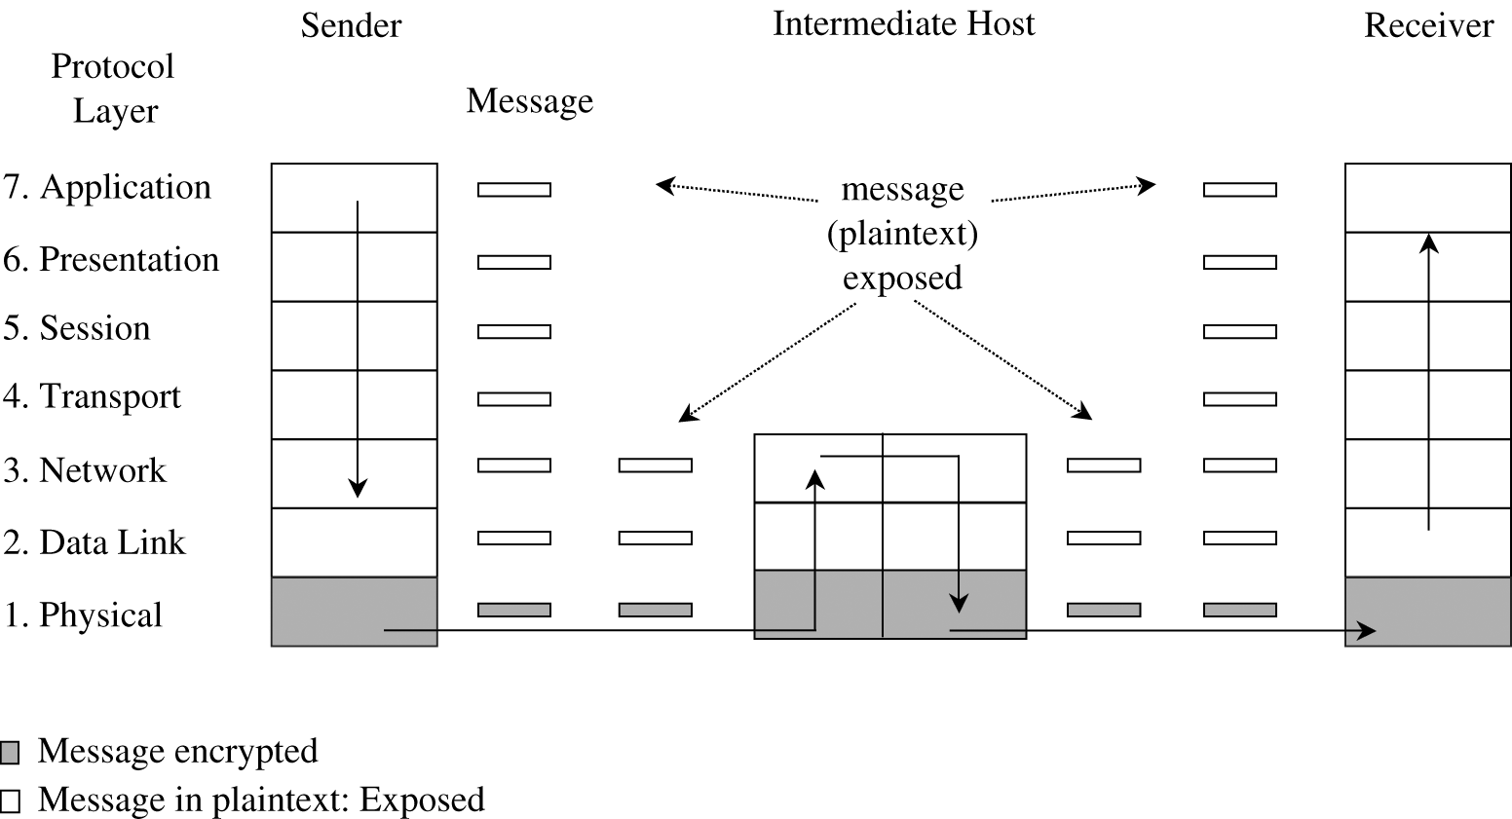
Network Security Controls (cont.)
Link Encryption
Data are encrypted just before the system places them on the physical communications link (at layer 1 or 2 in the OSI model)
Decryption occurs just as the communication arrives at and enters the receiving computer
Encryption protects the message in transit between two computers, but the message is in plaintext inside the hosts

Slide 45
Network Security Controls (cont.)
Link Encryption (cont.)
The message is exposed in two layers of all intermediate hosts through which the message may pass
This exposure occurs because routing and addressing are not read at the bottom layer, but only at higher layers.
Appropriate when the transmission line is the point of greatest vulnerability and the communications medium is shared with other users or is not secure

Slide 46
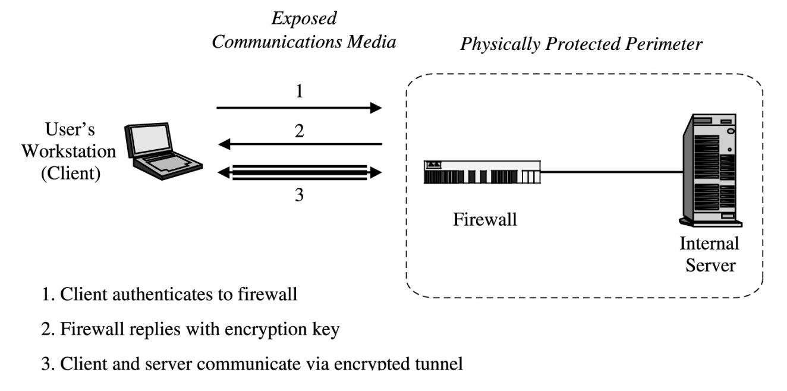
Network Security Controls (cont.)
Link Encryption (cont.)
Virtual Private Networks (VPN)
Firewalls can be used to implement a VPN
The larger network is restricted only to those given special access by the VPN
Communication passes through an encrypted tunnel or tunnel

Slide 47
Virtual Private Network (V P N) Concentrator (1 of 2)
Virtual private network (V P N) - enables authorized users to use an unsecured public network as if it were a secure private network
All data transmitted between remote device and network is encrypted
Types of V P Ns
Remote-access V P N - a user-to-LAN connection
Site-to-site - multiple sites can connect to other sites over the Internet
Always-on V P Ns – allow the user to always stay connected
Endpoints
The end of the tunnel between V P N devices may be software on local computer or a V P N concentrator

Slide 48
Virtual Private Network (V P N) Concentrator (2 of 2)
V P N concentrator - a dedicated hardware device that aggregates hundreds or thousands of V P N connections
When using a V P N, there are two options:
All traffic is sent to the V P N concentrator and protected (called a full tunnel)
Only some traffic is routed over the secure V P N, while other traffic directly accesses the Internet (called split tunneling)

Slide 49
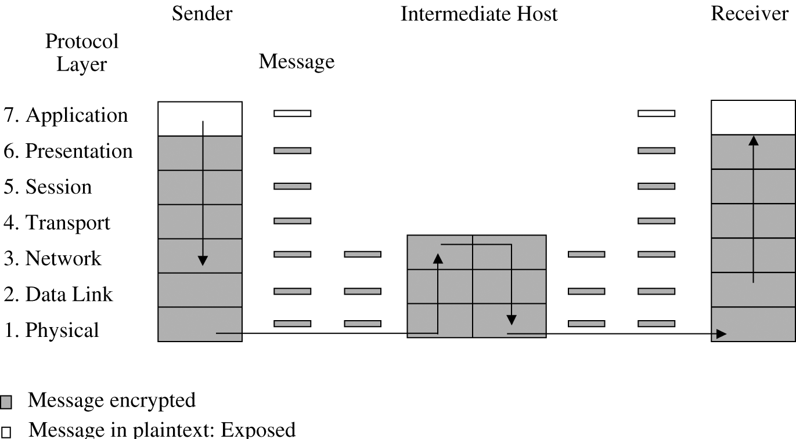
Network Security Controls (cont.)
End-to-End Encryption
Provides security from one end of a transmission to the other
Encryption is performed at the highest levels, layer 7, application, or layer 6, presentation, of the OSI model

Slide 50
Network Security Controls (cont.)
Public Key Infrastructure (PKI)
A process created to enable users to implement public key cryptography
Offers each user a set of services
Create certificates associating a user’s identity with a key
Give out certificates from its database
Sign certificates, adding its credibility to the authenticity of the certificate
Confirm (or deny) that a certificate is valid
Invalidate certificates for users who no longer are allowed access or whose private key has been exposed

Slide 51
Network Security Controls (cont.)
Public Key Infrastructure (PKI) (cont.)
Certificate Authority
Implements the PKI policy on certificates
Actions
Managing public key certificates for their whole life cycle
Issuing certificates by binding a user’s or system’s identity to a public key with a digital signature
Scheduling expiration dates for certificates
Ensuring that certificates are revoked when necessary
Registration Authority
An interface between a user and a certificate authority
Example
Passport-issuing office as a certificate authority
Postal service as a registration authority
Quality of registration authority determines the level of trust that can be placed in the issued certificates

Slide 52
Network Security Controls (cont.)
Public Key Infrastructure (PKI) (cont.)
Certificate authority should be approved and verified by an independent body
Certificate authority’s private key should be stored in a tamper-resistant security module
Access to the certificate and registration authorities should be tightly controlled, by means of strong user authentication such as smart cards
More than one operator should be required to authorize certification requests
Controls should be put in place to detect hackers and prevent them from issuing faked certificate requests
Secure audit trail is necessary for reconstructing certificate information in case of system fail and recovering

Slide 53
Network Security Controls (cont.)
Content Integrity
potential threats:
Malicious modification that changes content in a meaningful way (addressed by encryption)
Malicious or non-malicious modification that changes content in a way that is not necessarily meaningful
Non-malicious modification that changes content in a way that will not be detected

Slide 54
Network Security Controls (cont.)
Content Integrity (cont.)
Error Detection
Parity check: An extra bit is added to an existing group of data bits depending on their sum or an exclusive OR
Hash codes
Huffman codes
Cryptographic Checksum: Reduces a block of data to a smaller digest whose value depends on each bit in the block
Prevents the attacker from changing the data block and changing the checksum value to match

Slide 55
Network Security Controls (cont.)
Authentication in Networks
One-Time Password
User and host both have access to identical lists of passwords
Password token: A device that generates a password that is unpredictable but that can be validated on the receiving end
Kerberos
Authentication in distributed systems
A central server provides authenticated tokens, tickets, to requesting applications
Ticket is
An unforgeable, nonreplayable, authenticated object
An encrypted data structure naming a user and a service that user is allowed to obtain

Slide 56
Network Security Controls (cont.)
Kerberos (cont.)
Initiating a session: Kerberos server sends two messages
To the user: a session key S_{G} (encrypted under the user’s password) for use in communication with the ticket-granting server (G) and a ticket T_{G} for the ticket-granting server
To the ticket-granting server: a copy of the session key S_{G} and the identity of the user, encrypted under a key shared between the Kerberos server and the ticket-granting server

Slide 57
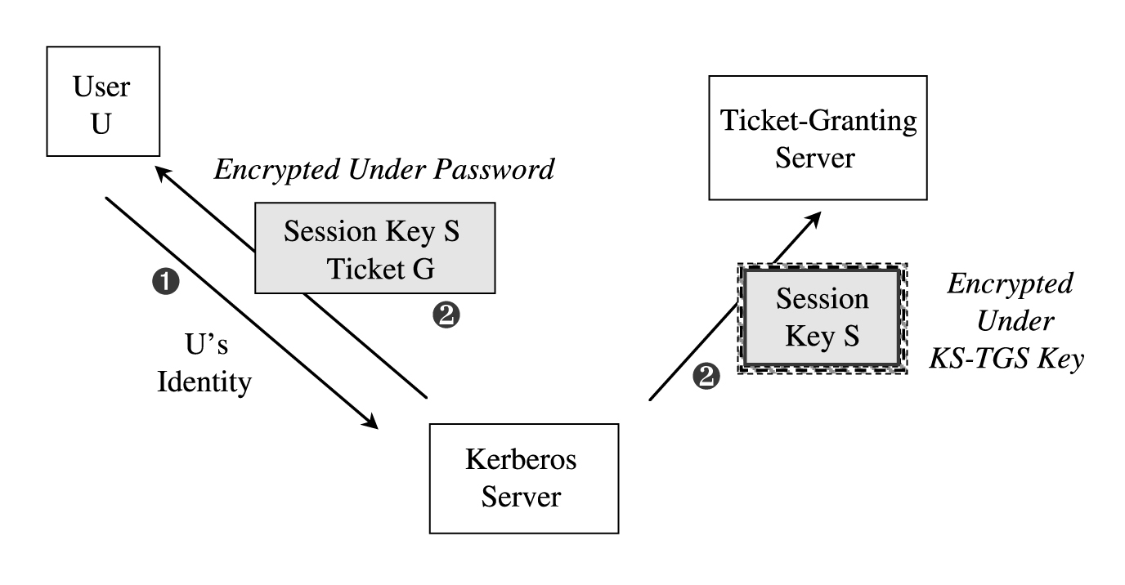
Network Security Controls (cont.)
Kerberos (cont.)
Initiating a Kerberos Session

Slide 58
Network Security Controls (cont.)
Kerberos (cont.)
Giving a service, say a file access
User, using the key S_{G} requests a ticket to access a file from the ticket-granting server
Ticket-granting server
Verifies user’s access permission
Returns a ticket and a session key. The ticket contains
User’s authenticated identity
An identification of the file
The access rights
A session key S_{F} for the file server to use while communicating this file to the user
An expiration date for the ticket
Ticket is encrypted under a key shared exclusively between the ticket-granting server and the file server
Ticket cannot be read, modified, or forged by the user

Slide 59
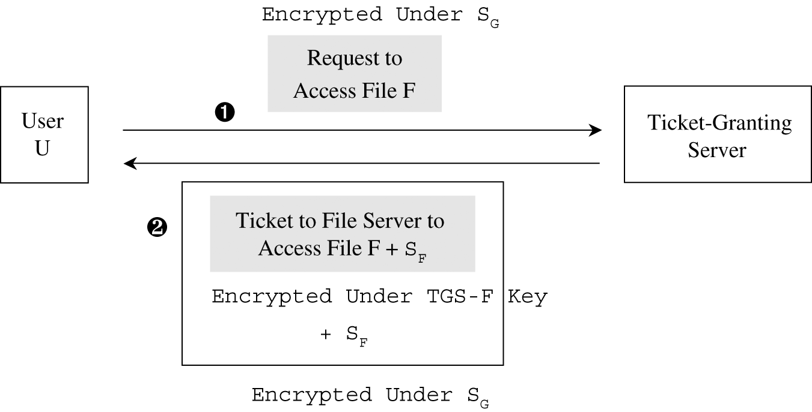
Network Security Controls (cont.)
Kerberos (cont.)
Obtaining a Ticket to Access a File

Slide 60
Firewalls
A device that filters all traffic between a protected (inside network) and a less trustworthy (outside network)
Main characteristics
Always invoked
All network accesses that that should be controlled must pass through it
Tamperproof
Well isolated, making it highly immune to modification
Implemented on a separate computer, with direct connections only to the outside and inside networks
Small and simple
Keeping the functionality of the firewall simple

Slide 61
Firewalls (cont.)
Types of firewalls
Packet filtering gateways or screening routers
Stateful inspection firewalls
Application proxies
Guards
Personal firewalls

Slide 62
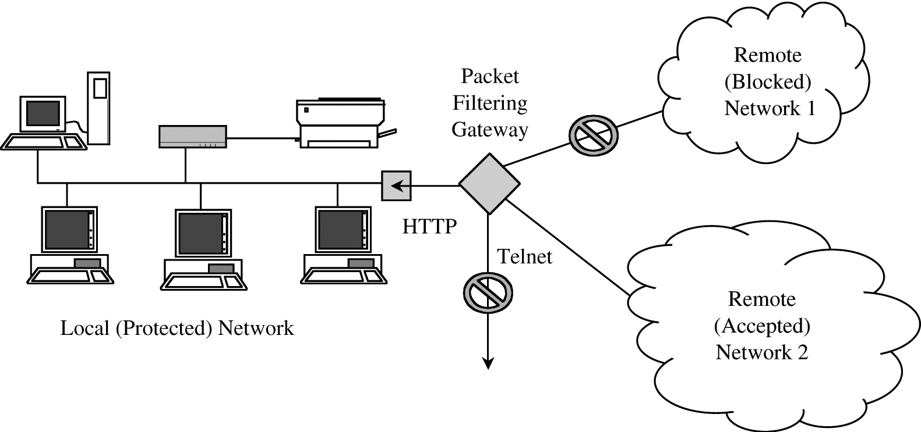
Firewalls (cont.)
Types of firewalls (cont.)
Packet filtering gateways or screening routers
Control access to packets on the basis of
Packet address (source or destination) or
Specific transport protocol type (such as HTTP web traffic)
Do not see inside a packet
Example: A packet filter that blocks access from (or to) addresses in one network; the filter allows HTTP traffic but blocks traffic using the Telnet protocol

Slide 63
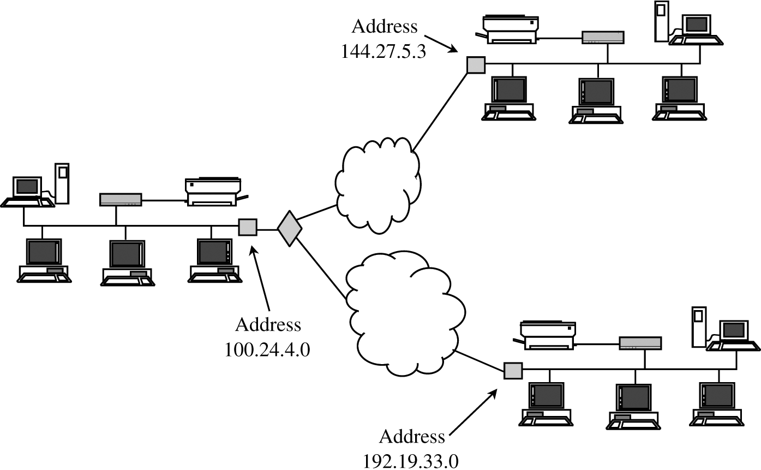
Firewalls (cont.)
Types of firewalls (cont.)
Packet filtering gateways or screening routers
Example: The company might want communication only among the three LANs of the corporate network. It could use a screening router on the LAN at 100.24.4.0 to allow in only communications destined to the host at 100.24.4.0 and to allow out only communications addressed either to address 144.27.5.3 or 192.19.33.0

Slide 64
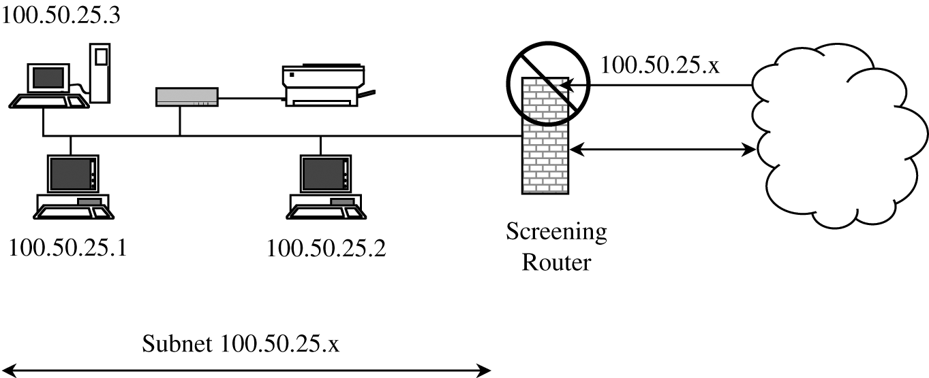
Firewalls (cont.)
Types of firewalls (cont.)
Packet filtering gateways or screening routers
Can block all packets from the outside that claimed their source address was an inside address
Filter Screening Outside Addresses

Slide 65
Firewalls (cont.)
Types of firewalls (cont.)
Stateful inspection firewalls
Keep track of the state of network connections
Do not treat each packet in isolation
Maintain state information from one packet to another in the input stream
Application Proxy
A firewall that simulates the effects of an application so that the application receives only requests to act properly
A two-headed device
It looks to the inside as if it is the outside (destination) connection
while to the outside it responds just as the insider would
Example
A company wants to set up an online price list so that outsiders can see the products and prices offered. It wants to be sure that
No outsider can change the prices or product list
Outsiders can access only the price list, not any of the more sensitive files stored inside.

Slide 66
Firewalls (cont.)
Types of firewalls (cont.)
Guard
Like a proxy firewall with more detailed functionalities
Examples
A school wants its students to be able to access the internet but, because of the slow speed of its connection to the web, it will allow only so many characters per downloaded image
A library wants to make available certain documents but, to support fair use of copyrighted matter, it will allow a user to retrieve only the first so many characters of a document
A company wants to allow its employees to fetch files via ftp. However, to prevent introduction of viruses, it will pass all incoming files through a virus scanner

Slide 67
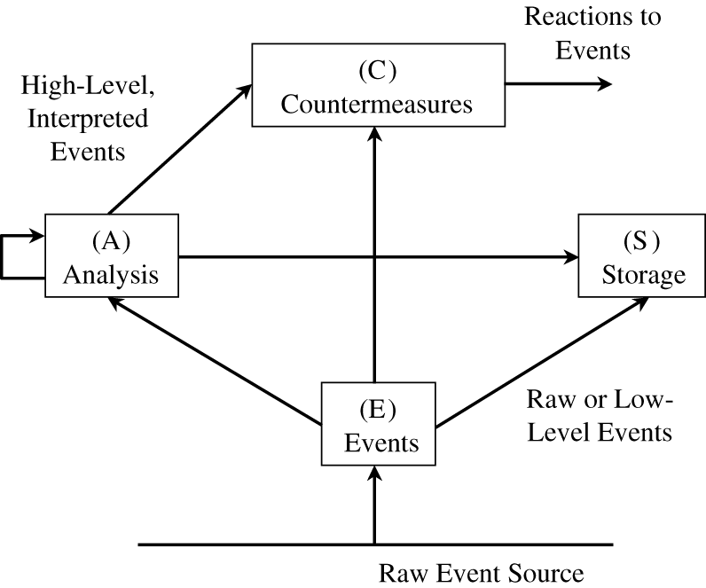
Intrusion Detection Systems (IDS)
A device, typically another separate computer, that monitors activity to identify malicious or suspicious events
Receives raw inputs from sensors, saves those inputs, analyzes them, and takes some controlling action
Common Components of an Intrusion Detection Framework

Slide 68
Intrusion Detection Systems (IDS) (cont.)
Functions:
Monitoring users and system activity
Auditing system configuration for vulnerabilities and misconfigurations
Assessing the integrity of critical system and data files
Recognizing known attack patterns in system activity
Identifying abnormal activity through statistical analysis
Managing audit trails and highlighting user violation of policy or normal activity
Correcting system configuration errors
Installing and operating traps to record information about intruders

Slide 69
Intrusion Detection Systems (IDS) (cont.)
Types of IDSs
Network-based
A stand-alone device attached to the network
Host-based
Runs on a single workstation or client or host
Signature-based
Performs simple pattern-matching and report situations that match a pattern corresponding to a known attack type
Cannot detect a new attack for which a signature is not yet installed in the database
Uses statistical analysis and Machine Learning models

Slide 70
Intrusion Detection Systems (IDS) (cont.)
Types of IDSs
Heuristic (anomaly based)
Builds a model of acceptable behavior and flag exceptions to that model
For the future, the administrator can mark a flagged behavior as acceptable so that the heuristic IDS will now treat that previously unclassified behavior as acceptable
State-based
See the system going through changes of overall state or configuration
Try to detect when the system has veered into unsafe modes
Model-based
Try to map current activity onto a model of unacceptable activity and raise an alarm when the activity resembles the model
Misuse
Real activity is compared against a known suspicious area

Slide 71
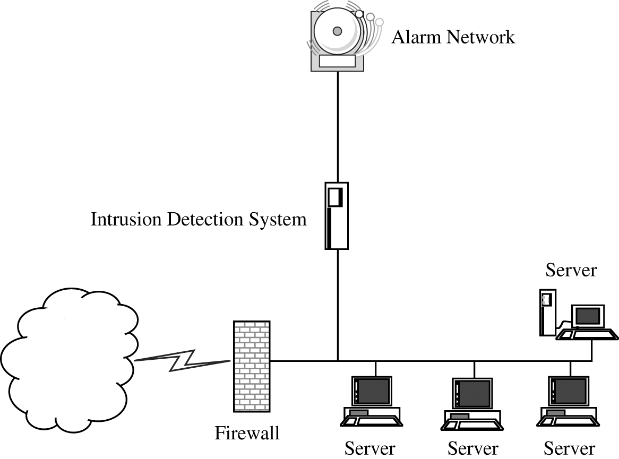
Intrusion Detection Systems (IDS) (cont.)
Stealth Mode
To prevent malicious activities against IDS, such as disabling it
Work as a passive wiretap

Slide 72
Intrusion Detection Systems (IDS) (cont.)
Responding to Alarms
Monitor, collect data, perhaps increase amount of data collected
Protect, act to reduce exposure
Call a human
False Results (System’s Sensitivity)
False Positive
Raising an alarm for something that is not really an attack
False Negative
Not raising an alarm for a real attack

Slide 73
Secure E-Mail
Threats to E-mail
Message interception (confidentiality)
Message interception (blocked delivery)
Message interception and subsequent replay
Message content modification
Message origin modification
Message content forgery by outsider
Message origin forgery by outsider
Message content forgery by the recipient
Message origin forgery by the recipient
Denial of message transmission
Notes:
Message Interception (Confidentiality): This threat involves unauthorized parties intercepting and reading the contents of an email, compromising its confidentiality. Attackers may use various techniques like sniffing or man-in-the-middle attacks to gain access to sensitive information.
Message Interception (Blocked Delivery): In this case, attackers intercept the email and prevent it from being delivered to its intended recipient. This can disrupt communication, leading to important messages being lost or delayed.
Message Interception and Subsequent Replay: This occurs when an attacker intercepts an email and then later sends the same message again. The replayed message can cause confusion, unauthorized actions, or redundancy. It’s often used in phishing attacks or fraud schemes.
Message Content Modification: Attackers alter the content of the email after intercepting it but before delivering it to the recipient. This can result in misinformation, fraudulent instructions, or manipulated data being communicated.
Message Origin Modification: In this scenario, an attacker alters the details regarding the sender of the email, making it appear as though the message came from someone else. This can be used to impersonate trusted individuals or institutions, leading to phishing attacks.
Message Content Forgery by Outsider: This occurs when an unauthorized external party creates or manipulates an email to make it appear authentic. The forger can insert false information or directives that seem legitimate to the recipient.
Message Origin Forgery by Outsider: Here, an external attacker forges the identity of the email's sender to deceive the recipient. The attacker’s goal is often to manipulate the recipient into performing actions they wouldn’t otherwise do, like clicking malicious links or sharing sensitive information.
Message Content Forgery by Recipient: In this situation, the recipient of an email modifies its content and claims that the modified content is the original. This can be used for fraud or in legal disputes to misrepresent communications.
Message Origin Forgery by Recipient: This threat arises when a recipient claims that the email came from someone else, or they alter the sender’s information in the received email. This can be used to deflect responsibility or mislead others about the source of a communication.
Denial of Message Transmission: In this scenario, the sender or recipient falsely denies having sent or received the message. This can be used to avoid accountability or responsibility for the contents of the communication.

Slide 74
Secure E-Mail (cont.)
Requirements
Message confidentiality
The message should not be exposed when routing to the receiver
Message integrity
What the receiver sees should be what was sent
Sender authenticity
Receiver should be confident aboutwho the sender was
Nonrepudiation
Sender cannot deny having sent the message

Slide 75
Secure E-Mail (cont.)
Confidentiality
The sender chooses a (random) symmetric algorithm encryption key
The sender encrypts a copy of the entire message to be transmitted, including FROM:, TO:, SUBJECT:, and DATE: headers
The sender prepends plaintext headers
The sender encrypts the message key under the recipient’s public key, and attaches that to the message as well

Slide 76
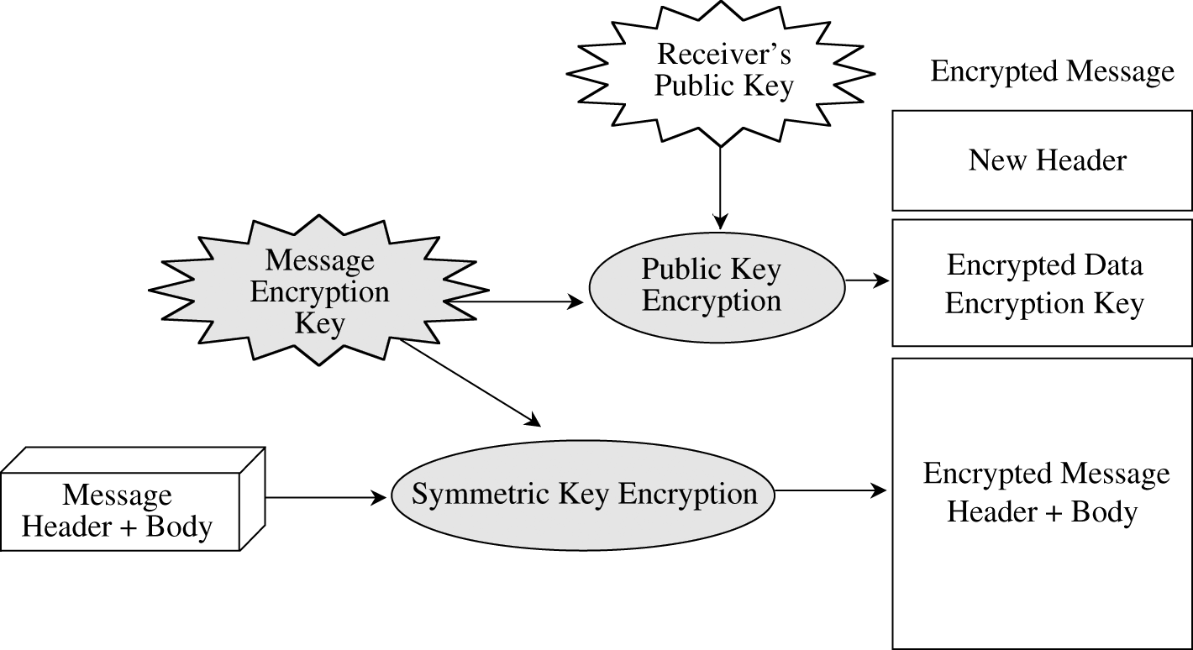
Secure E-Mail (cont.)
Overview of Encrypted E-Mail Processing

Slide 77
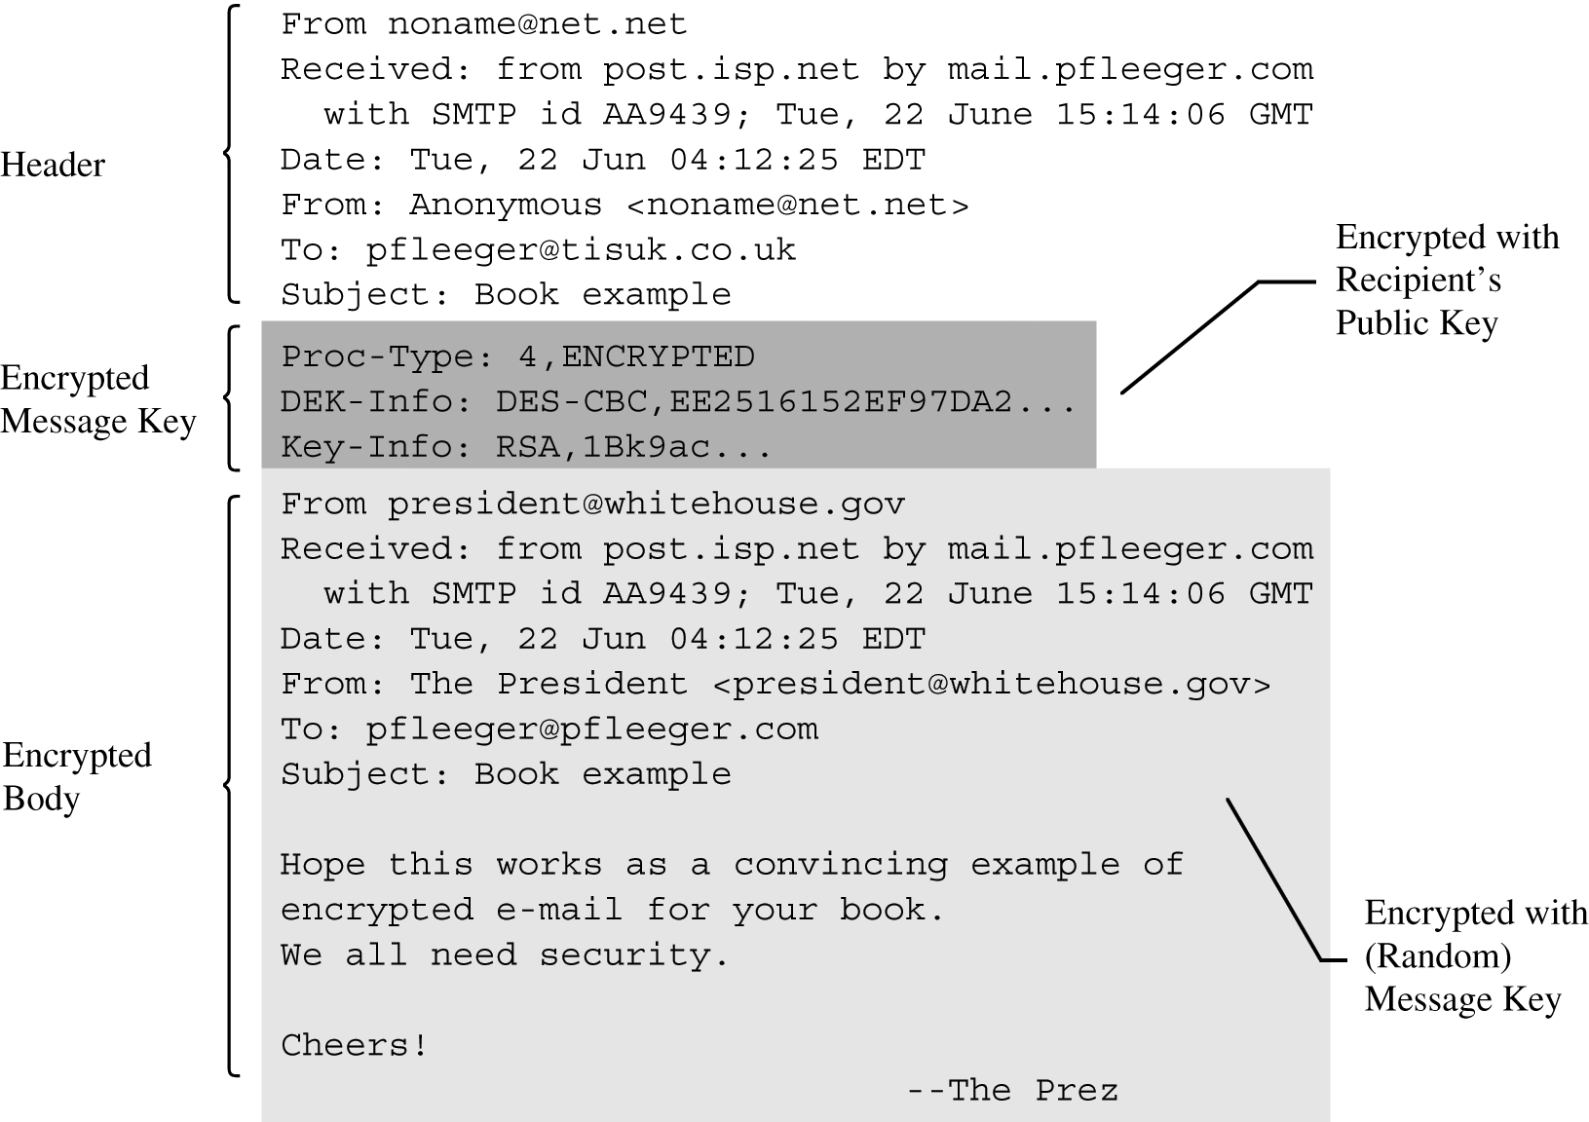
Secure E-Mail (cont.)
Encrypted E-Mail–Secured Message

Slide 78
Secure E-Mail (cont.)
PGP (Pretty Good Privacy)
Create a random session key for a symmetric algorithm.
Encrypt the message, using the session key (for message confidentiality).
Encrypt the session key under the recipient’s public key.
Generate a message digest (summary) or hash of the message; sign the hash by encrypting it with the sender’s private key (for message integrity and authenticity).
Attach the encrypted session key to the encrypted message and digest.
Transmit the message to the recipient

Slide 79
Secure E-Mail (cont.)
S/MIME (Secure Multipurpose Internet Mail Extensions)
The principal difference between S/MIME and PGP is the method of key exchange
PGP depends on each user’s exchanging keys with all potential recipients and establishing a ring of trusted recipients
It also requires establishing a degree of trust in the authenticity of the keys for those recipients
S/MIME uses hierarchically validated certificates for key exchange
Thus, with S/MIME, the sender and recipient do not need to have exchanged keys in advance as long as they have a common certifier they both trust
It handles e-mail attachments as well

Slide 80
Security and Information Event Management (S I E M) (1 of 3)
Security and Information Event Management (S I E M) product
A S I E M consolidates real-time monitoring and management of security information
Analyzes and reports on security events
A S I E M product can be:
A separate device
Software that runs on a computer
A service that is provided by a third party
80

Slide 81
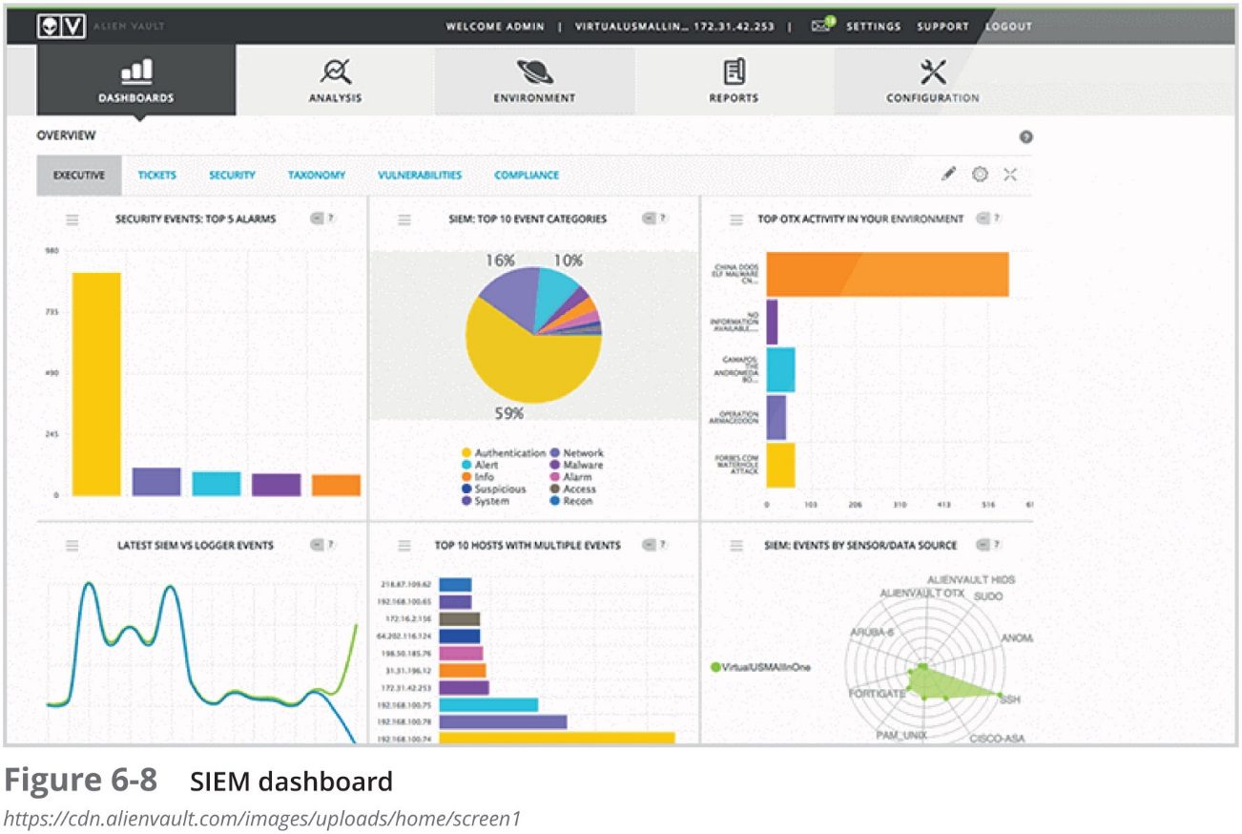
Security and Information Event Management (S I E M) (2 of 3)
81

Slide 82
Security and Information Event Management (S I E M) (3 of 3)
A S I E M typically has the following features:
Aggregation
Correlation
Automated alerting and triggers
Time synchronization
Event duplication
S I E M logs
82
Notes:
Aggregation: SIEM tools aggregate data from various sources like network devices, servers, and security systems. This provides a centralized view of security-related information, simplifying the analysis of logs and events from multiple environments.
Correlation: SIEM tools correlate the aggregated data to identify patterns that could indicate suspicious activities or threats. For instance, multiple failed login attempts followed by a successful one from an unknown IP could raise a security alert.
Automated Alerting and Triggers: SIEM systems can automatically generate alerts based on predefined rules and conditions. When certain conditions or patterns are detected in the logs, the system can trigger alerts or even take predefined actions, like blocking an IP address.
Time Synchronization: SIEM systems require synchronized timestamps across different data sources to accurately correlate events. Without synchronized time, it would be difficult to establish event sequences, which is crucial for detecting threats.
Event Duplication: SIEMs can detect and filter out duplicate events from the same source or across multiple systems, preventing an overload of unnecessary information and improving the quality of the alerts.
SIEM Logs: SIEM systems collect and store logs from different systems for analysis. These logs serve as a vital resource for tracking historical data, conducting forensic investigations, and complying with security regulations.

Slide 83
Other Network Security Hardware Devices (1 of 2)
Name | Description | Comments
Hardware security module | A dedicated cryptographic processor that provides protection for cryptographic keys | A tamper-resistant device that can securely manage, process, and store cryptographic keys
S S L decryptor | A separate device that decrypts S S L traffic | Helps reduce performance degradation and eliminates the need to have multiple decryption licenses spread across multiple devices
S S L/T L S accelerator | A separate hardware card that inserts into a web server that contains one or more co-processors to handle S S L/T L S processing | Used to accelerate the computationally intensive initial SSL connection handshake, during which keys are generated for symmetric encryption using 3 D E S or A E S
Media gateway | A device that converts media data from one format to another | Sometimes called a softswitch, converts data in audio or video formats
83
Notes:
SSL (Secure Sockets Layer): This was the original encryption protocol, developed in the 1990s, and was widely used to secure web traffic. However, due to various security vulnerabilities, SSL is now considered outdated and has been replaced by TLS.
TLS (Transport Layer Security): TLS is the successor to SSL and provides stronger encryption methods and security measures. It ensures that the communication between the client and server is encrypted, preventing third parties from eavesdropping or tampering with the data in transit. It has undergone several updates, with the most recent being TLS 1.3, which includes enhanced security features and improved performance.
SSL (Secure Sockets Layer) handshake process normally uses cryptographic keys for symmetric encryption wich are generated using algorithms like 3DES (Triple Data Encryption Standard) or AES (Advanced Encryption Standard).

Slide 84
Other Network Security Hardware Devices (2 of 2)
Name | Description | Comments
Unified Threat Management (U T M) | Integrated device that combines several security functions | Multipurpose security appliance that provides an array of security functions, such as antispam, antiphishing, antispyware, encryption, intrusion protection, and web filtering
Internet content filter | Monitors Internet traffic and block access to preselected websites and files | Restricts unapproved websites based on U R L or by searching for and matching keywords such as sex or hate as well as looking for malware
Web security gateway | Blocks malicious content in real time as it appears without first knowing the U R L of a dangerous site | Enables a higher level of defense by examining the content through application-level filtering
84
Notes:
UTM devices typically provide functions such as firewall, antivirus, intrusion detection and prevention, content filtering, spam filtering, and virtual private network (VPN) capabilities. This approach simplifies the management and monitoring of network security by offering a consolidated platform for defending against a wide range of threats.

Slide 85
Security Through Network Architecture
The design of a network can provide a secure foundation for resisting attackers
Elements of a secure network architectural design include:
Creating security zones
Using network segregation
85
Notes:
Creating Security Zones: Security zones are distinct segments within a network that isolate resources and applications based on their security needs. For instance, a demilitarized zone (DMZ) might be created to house publicly accessible services, keeping them separate from the internal network to reduce the risk of external threats. By compartmentalizing network sections, administrators can enforce stricter security measures for sensitive areas and monitor traffic closely.
Using Network Segregation: Network segregation is the practice of dividing a network into smaller, isolated sub-networks or segments. This minimizes the spread of potential threats within the network and allows administrators to apply specific security controls to each segment. It helps prevent an attacker from easily moving from one part of the network to another if a breach occurs.

Slide 86
Security Zones
A secure approach is to create zones to partition the network
So that certain users may enter one zone while access is prohibited to other users
The most common security zones:
Demilitarized zones (DMZ)
Using network address translation to create zones
86

Slide 87
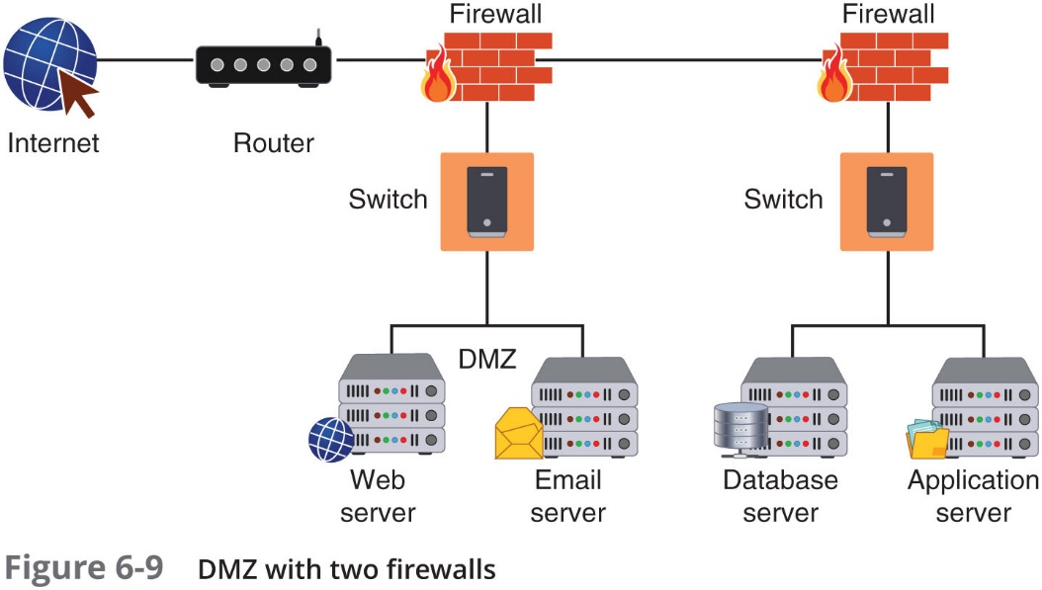
Demilitarized Zone (D M Z)
D M Z - a separate network located outside secure network perimeter
Untrusted outside users can access D M Z but not secure network
87

Slide 88
Network Address Translation (N A T) (1 of 2)
Network address translation (N A T)
Allows private I P addresses to be used on the public Internet
Replaces private I P address with public address
Advantage of N A T
Masks I P addresses of internal devices
An attacker who captures the packet on the Internet cannot determine the actual I P address of sender
88

Slide 89
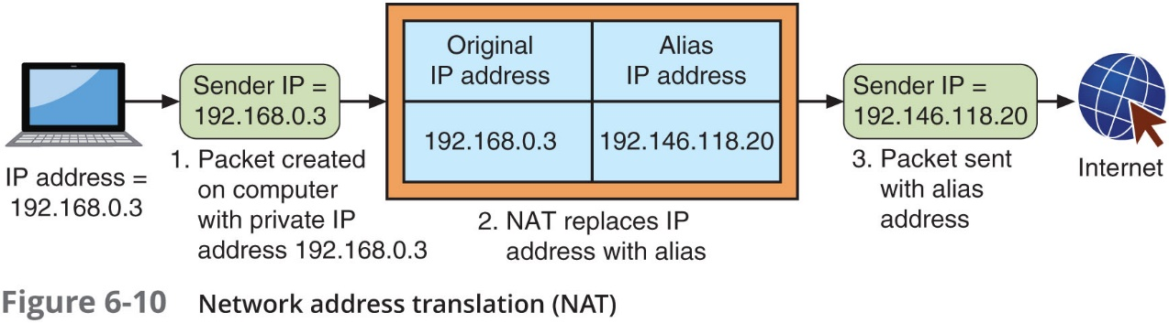
Network Address Translation (N A T) (2 of 2)
89

Slide 90
Other Zones
Name | Description | Security benefits
Intranet | A private network that belongs to an organization that can only be accessed by approved internal users | Closed to the outside public, thus data is less vulnerable to external threat actors
Extranet | A private network that can be access by authorized external customers, vendors, and partners | Can provide enhanced security for outside users compared to a publicly accessible website
Guest network | A separate open network that anyone can access without prior authorization | Permits access to general network resources like web surfing without using the secure network
90

Slide 91
Network Segregation (1 of 2)
Physical network segregation
Isolates the network so that it is not accessible by outsiders
Air gap
The absence of any type of connection between devices
In this case the secure network and another network
Networks can be segmented using switches to divide the network into a hierarchy
Core switches reside at the top of the hierarchy and carry traffic between switches
Workgroup switches are connected directly to the devices on the network
91

Slide 92
Network Segregation (2 of 2)
Virtual LAN (V LAN)
Allow scattered users to be logically grouped together
Even if attached to different switches
Can isolate sensitive data to V LAN members
Communication on a V LAN
If connected to same switch, switch handles packet transfer
A special “tagging” protocol is used for communicating between switches
92

Slide 93
Security Through Network Technologies
Two technologies that can help secure a network:
Network access control
Data loss prevention
93

Slide 94
Network Access Control (N A C) (1 of 3)
N A C
Examines the current state of a system or network device before it can connect to the network
Any device that does not meet a specified set of criteria can connect only to a “quarantine” network where the security deficiencies are corrected
Goal of N A C
To prevent computers with suboptimal security from potentially infecting other computers through the network
94

Slide 95
Network Access Control (N A C) (2 of 3)
N A C uses software “agents” to gather information and report back (host agent health checks)
An agent may be a:
Permanent N A C agent
Dissolvable N A C agent – disappears after reporting information to the N A C
N A C technology can be embedded within a Microsoft Windows Active Directory domain controller
N A C uses A D (Active Directory) to scan the device (called agentless N A C)
95

Slide 96
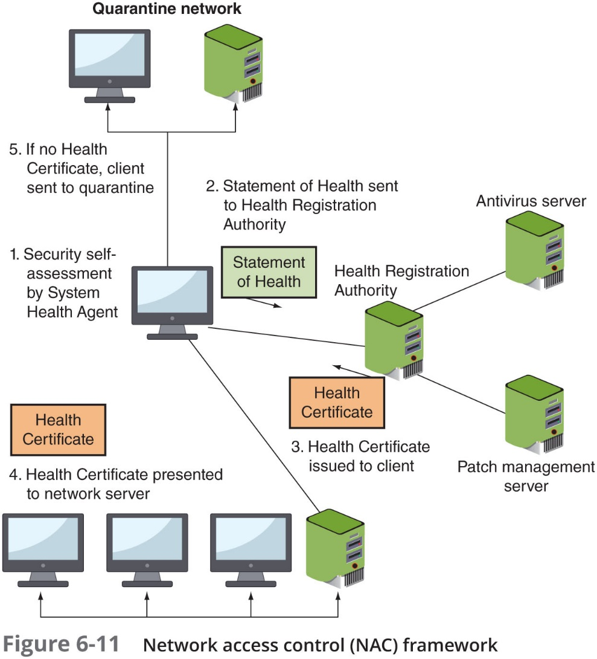
Network Access Control (N A C) (3 of 3)
96

Slide 97
Data Loss Prevention (D L P) (1 of 3)
D L P
A system of security tools that is used to recognize and identify data that is critical to the organization
Ensures that it is protected
Two common uses of D L P
Monitoring emails through a mail gateway
Blocking the copying of files to a U S B flash drive (U S B blocking)
Most D L P systems use content inspection
Defined as a security analysis of the transaction within its approved context
97
Notes:
Content inspection is a core feature of DLP systems, allowing them to analyse data transactions within their approved context. There are multiple methods of content inspection, each with its own strengths and use cases. These include pattern matching (like regex), fingerprinting, file matching, statistical analysis, Conceptual/Semantic Analysis analysis, Optical Character Recognition (OCR), Key-word or Lexicon-based Analysis, and Data Classification Tags. Most DLP systems use a combination of these methods to provide thorough protection against data loss while minimizing false positives and negatives. The choice of inspection method(s) depends on the type of data being protected, the organization's specific needs, and the desired balance between security and system performance.

Slide 98
Data Loss Prevention (D L P) (2 of 3)
Content inspection looks at not only the security level of data, but also:
Who is requesting it
Where the data is stored
When it was requested
Where it is going
Three types of D L P sensors:
D L P network sensors
D L P storage sensors
D L P agent sensors
98
Notes:
DLP Network Sensors:
These sensors monitor data as it moves across the network. They can intercept and analyze data in transit, checking for sensitive or confidential information. They help prevent unauthorized data transmissions from leaving the network.
DLP Storage Sensors:
These sensors scan and monitor data at rest, i.e., data stored in databases, file systems, or cloud storage. They ensure that sensitive data stored in these systems complies with security policies and is not being improperly accessed or retained.
DLP Agent Sensors:
These are typically installed on endpoints like workstations or laptops. Agent sensors monitor activities on devices and ensure that sensitive information is not copied, modified, or transmitted without proper authorization. They can prevent data leakage from within the organization.

Slide 99
Data Loss Prevention (D L P) (3 of 3)
When a policy violation is detected by the D L P agent
It is reported back to the D L P server
Different actions can be taken:
Block the data
Redirect it to an individual who can examine the request
Quarantine the data until later
Alert a supervisor of the request
99

